Slide 1
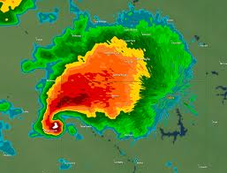
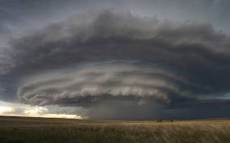
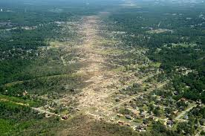
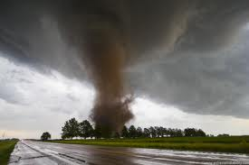
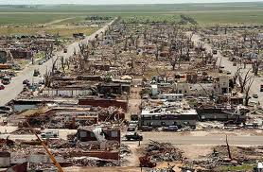
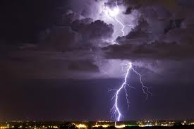
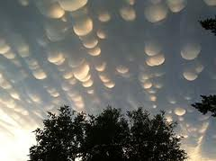
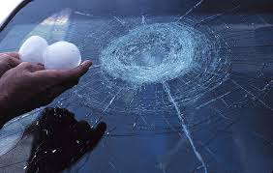
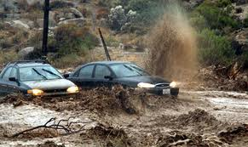
Severe Weather
Mike DiDomizio
Billy Clark
Sydney Daniel

Slide 2
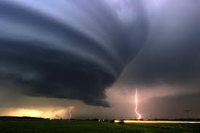
Outline
Introduction
How is severe weather categorized?
Physical Mechanisms
Vulnerability
Physical
Social
Examples

Slide 3
How Severe is Severe?
Refers to any dangerous meteorological phenomena with the potential to cause damage, serious social disruption, or loss of human life.
Three severe thunderstorm categories
Approaching Severe
Severe
Significantly Severe

Slide 4
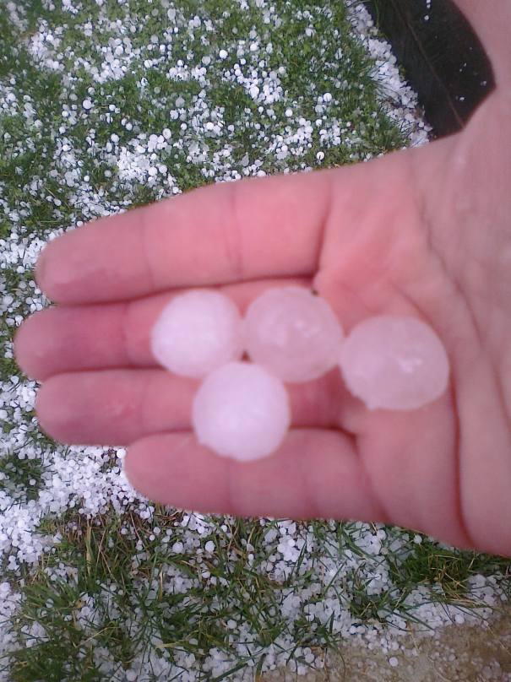
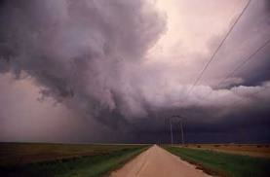
Approaching Severe
Defined as hail between ¹⁄₂ to 1 inch diameter or winds between 50 and 58 M.P.H. (50 knots).

Slide 5
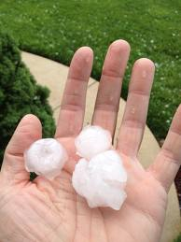
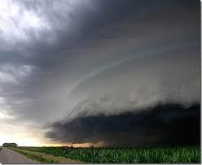
Severe
Defined as hail 1 inch diameter or larger, winds 58 mph or stronger, or a tornado.

Slide 6
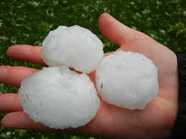
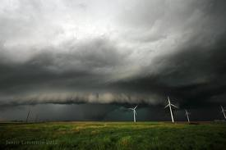
Significantly Severe
Defined as hail 2 inches in diameter or larger, winds above 75 mph, a tornado of strength EF2 or stronger, and the occurrence of flash floods by heavy precipitation.

Slide 7
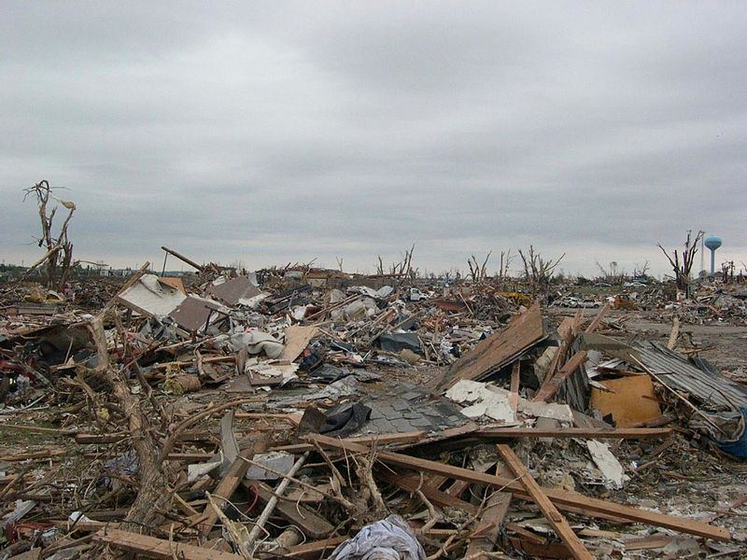
Tornadoes
Dangerous rotating column of air in contact with both the ground and base of a cumulonimbus cloud (thundercloud).
Six categories:
EF0- 65–85 mph
EF1- 86–110 mph
EF2- 111–135 mph
EF3- 136–165 mph
EF4- 166–200 mph
EF5- >200 mph

Slide 8
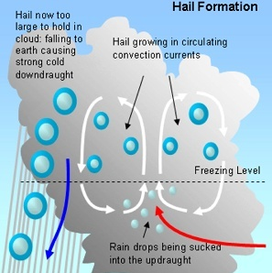
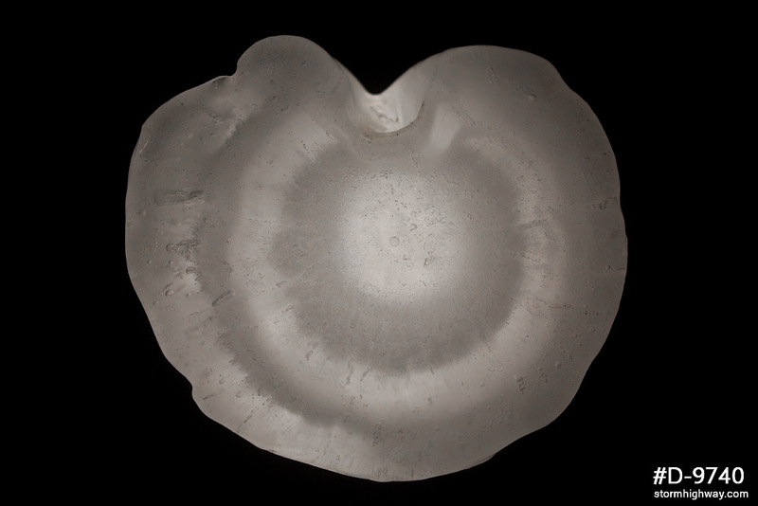
HAIL
Rain falls from a strong thunderstorm and gets sucked back up.
The rain freezes high up in the cloud and falls again
Process continues till heavy enough to fall to the earth.
Creates layers

Slide 9
Oklahoma City Hail Storm - May 16, 2010
http://www.youtube.com/watch?v=ABlrCHM9IhU

Slide 10
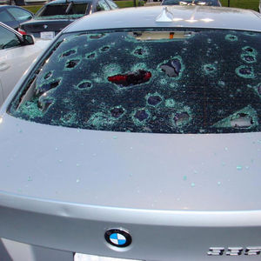
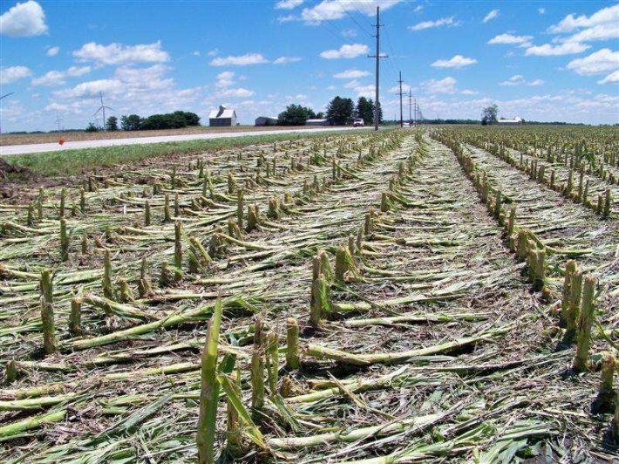
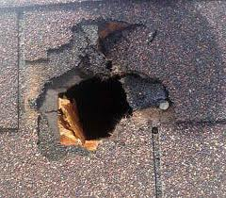
Damage
Cars/ windshields
Roofs
Crops
Livestock
Large cities can accrue hundreds of millions in damage

Slide 11
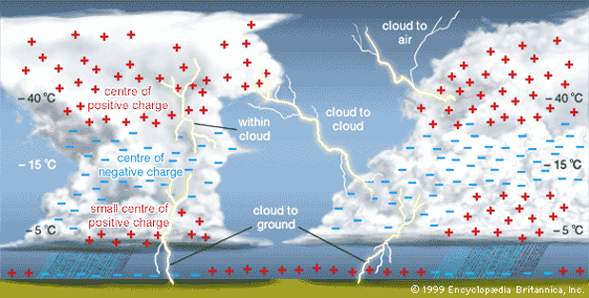
Lightning Process
Lightning comes from cumulonimbus clouds
It is a build-up of static electricity by colliding ice and snow particles in the cloud
The flash usually is the return strike
Thunder heard usually 5 sec. per mile after flash.

Slide 12
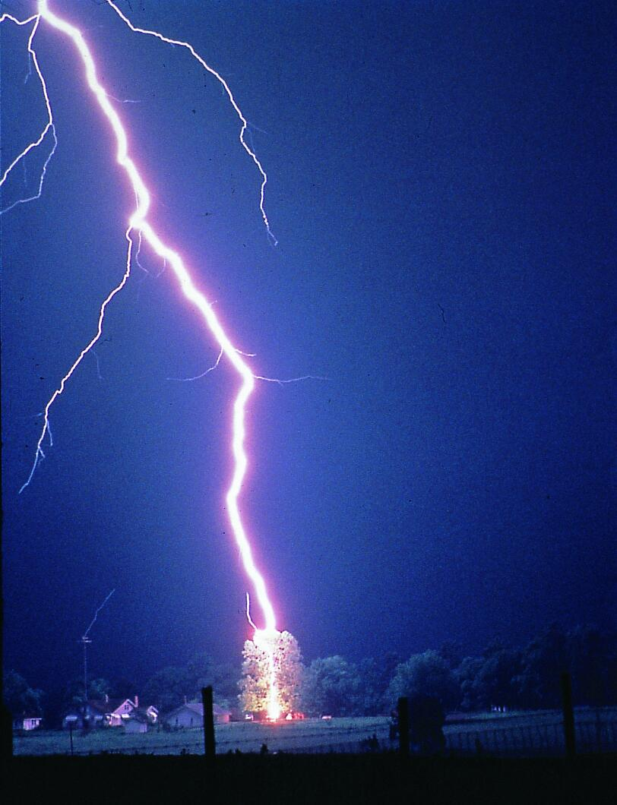
Lightning Criteria
Lightning actually isn't a criteria for severe weather
Still very dangerous, 28 deaths in 2012
Florida has the highest lightning occurrence in the US (5 deaths last year)

Slide 13
Lightning
http://www.youtube.com/watch?v=lUUOdO6eEZA

